Slide 1
Typical Business Cycles
Empirical
Demand (Supply) Shock
Inventory, Capacity Accumulation (Debt Financed)
Business Balance Sheet Deterioration
Short Sharp Contraction (6-9 months)
Inventory, Investment Reduction
Business Cash Flow Improvement
Balance Sheet Restoration, Expansion (48 Months Plus)
Theoretical
Firms Have Informational (Tax) Incentives to Lever-Up
Informational Constraints Restrict Financial Market
  Deleveraging (Equity Sale) Especially Under Crisis Conditions
  Balance Sheet Restoration From Internal Cash Flows and Information Acquisition Over Time

Slide 2
Long Term Cycles
Depression 1930-2 Contraction
Relatively Slow Recovery
Non-Recovery (Argentina)
Current Recession
Long-Lived Contraction
(Greece, Italy, Europe)
Relatively Slow Recovery
(Japan)

Slide 3
Depression Analysis
Agricultural Collapse
      1920s Weak
      1929-32 Price Collapse
      1929-32 Income Collapse
      1930-32 Mobility Collapse
        (30-35% US Population)
Transmission to Broader Economy
      Agricultural Demand Collapse Outweighs Benefits of Lower Food Prices
      Rural Service Income Collapse
      Debt Deflation Impact
International Competition
      Country Recoveries Related to Devaluations (Argentina, Australia)
      Devaluation Constraint Prevent Global Recovery
Policy Solution
      World War II Finances Rural to Urban Transition
      Non-Reappearance of Depression
      Non-Recovery (Argentina)

Slide 4
Current Crisis
Manufacturing Collapse
        Temporally Extended
        (US 1979-84; Japan 1989, Asia Crisis)
        Crisis Generated by Huge Asian Capacity
        Additions (Post – 2000)
        Transmission to Broader Economy
        International Competition
        - Asian Currency Management
        - Euro Imbalances
        Policy Solution
        - Nowhere in Sight

Slide 5
Basic Elements of the Model
Deteriorating Fundamentals Lead to Immobility Constraint
  Transition Requires Significant Investment (Labor)
    Relocation
    Retraining
    Job Search Interim Support
  Sectoral Wealth Impairment Prevents Self-Financing
  Informational Constraints Prevent Alternative Finances
  Immobility Amplifies Sectoral Deterioration – No Relief in Supply from Outmigration
  Aggregate Demand Impact of Sectoral Deterioration in Income Outweighs Benefit of Favorable Price Trend
    Income Constrained Consumers Adjust More Than Unconstrained Consumers
    Standard Debt – Deflation Issues
    Uncertainty in Impacts on Wealth/Debt
    Substitution Effect
  International Competition

Slide 6
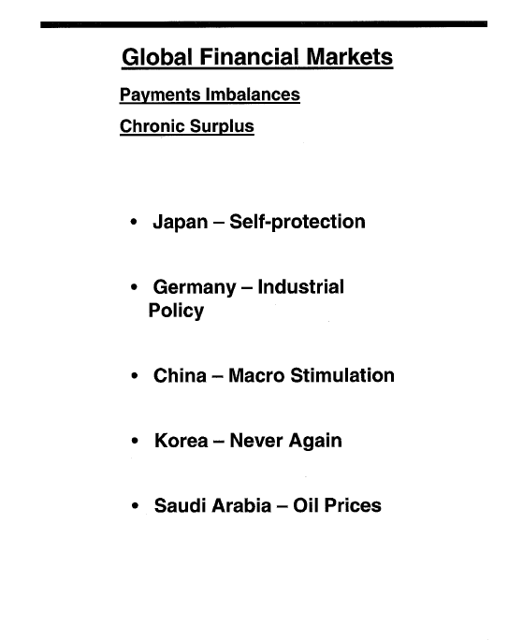

Slide 7
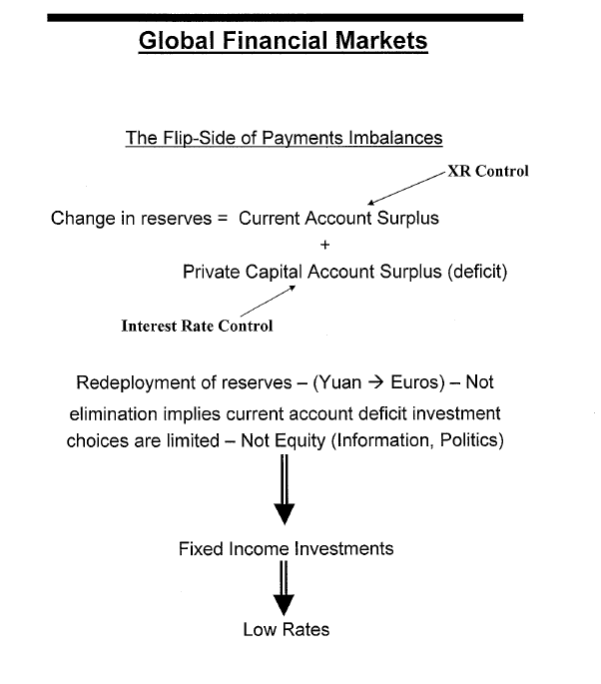

Slide 8
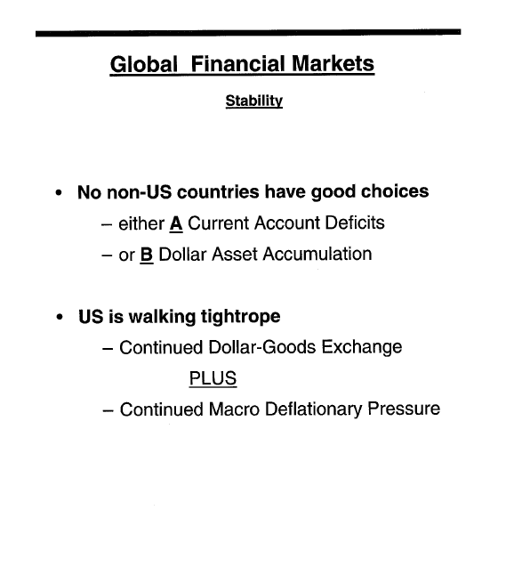

Slide 9




Deficit Country Macrostability
Output= Income + Exogenous Spending- Leakage
I & G
Taxes+ RE + (M- X)+ NPS
@ 6-7% of Output
Very Hard to Make Up
1. Internet Investment Boom
2. Housing Boom (1994-1999) (2000-2005)
3. NPSaving = 0

Slide 10
This Time There Are Differences
Income Stabilizing Effects Government/Private Institutions
More Limited Issue of Geographic/Cultural Separation
Stabilizing Effects of Non-Commodity Markets
  Moderates Impact, Not Duration
  Distribution of Income Effects – Profits/Wages, Within Wages
  Impact on Investment – Services vs. Manufacturing
  Impact of Mobility Constraints on Productivity Growth

Slide 11
Sources of Profitability
Assets
Franchises (Barriers-to-entry)
  Sustainable Competitive Advantages
    Economies-of-scale
    Customer Captivity
Key is 'local' market dominance (Products, Geography)
Services not manufacturing
Perceived risk
productivity growth
5

Slide 12
Profita biIity
United States
YEARS
CORPORATE PROFITS/ NATL INCOME
BUS INV/GDP
1989-91 | 8.8%
1995 | 11.0% | 10.9%
1999-2001 | 9.3% | 12.3%
2005 | 12.9% | 10.7%
2006 | 13.4% | 11.3%
2007 | 12.2% | 11.7%
2008 | 9.9% | 11.6%
2009 | 11.1% | 9.7%
2010 | 13.3% | 9.2%
2011 | 13.7% | 9.8%
2012 | 14.1% | 10.3%
2013 | 14.2% | 10.0%
2014 | 13.9% | 9.9%

Slide 13
Productivity Growth Output Per Man-Hour
 | Level 2011 | 2000-2011 | 2009-11 | 2009
United States | 100 | 2.0 | 1.7 | 2.5
Japan | 69 | 1.7 | 2.3 | -0.8
United Kingdom | 78 | 1.7 | 0.5 | -1.9
Germany | 93 | 1.3 | 0.3 | -2.5
France | 96 | 1.2 | 0.7 | -0.6
Canada | 77 | 1.0 | 0.8 | 0.7
Italy | 76 | 0.3 | 0.1 | -2.2

Slide 14
Inflation Rates
 | GDP Deflator | Consumption Deflator
2008 | 2.2% | 3.3%
2009 | 0.9% | 0.1%
2010 | 1.3% | 1.9%
2011 | 2.1% | 2.4%
2012 | 1.8% | 1.8%
2013 | 1.5% | 1.2%
2014 | 1.5% | 1.3%
Average | 1.7% | 1.7%

Slide 15
John Deere
Cyclical Experience
1999 2000 2001 2002 2003 2007 2008 2009 2010 2011
Revenues($B) 9.8 11.4 11.2 12.0 13.6 21.9 26.2 21.1 24.0 29.9
Margin (%) 3.7 6.8 0 3.7 5.3 11.2 11.4 6.8 12.0 12.9

Slide 16
This Time Its Different – Wage Dispersion
Services are Locally/Individually Produced
Performances Differences Less Affected by Aggregation
Stigler Data on Professional vs. Aggregate Wage Dispersion

Slide 17
US Savings Rate
Year 1970 | Consumption 621.7
1975 | 976.4
1980 | 1,670.1
1985 | 3,109.3
1990 | 4,285.8
1995 | 5,408.2
2000 | 7,194.0
2001 | 7,486.8
2002 | 7,830.1
2003 | 8,162.5
2004 | 8,681.6
2005 | 9,036.1
Disposable | Savings
Income | Rate
695.3 | 10.6
1,096.1 | 10.9
1,821.8 | 8.3
2,720.3 | 9.0
3,839.9 | 7.0
4,975.8 | 4.6
6,739.4 | 2.3
7,055.0 | 1.8
7,350.7 | 2.4
7,703.6 | 2.1
8,211.5 | 2.0
8,742.4 | -0.4

Slide 18
Implications of Zero Savings
Top 20%:
40% of Income
x 15 % Savings Rate
= 6 % Savings
Bottom 80%:
= - 6 % Savings (Total = 0)
Income= 60 %
Savings Rate = - 10 %

Slide 19
Mobility Issues - Productivity
Productivity Growth Opportunities are Local Within/Across Organizations (Baily Data)
Resources Must Be Locally Available
Immobility – Labor, Capital, Institutional Capacity, Government Support – Creates Mismatch Between Opportunities and Resources

Slide 20
JAPAN-US GROWTH DIFFERENTIAL
AGGREGATE PRIVATE
(PERCENT PA)
Period Productivity (Per MH) Hours Worked (MH)
 | Japan | US | Japan-US |  | Japan | US | Japan-US
1970-80 | 4.3 | 1.5 | 2.8 |  | 0.2 | 1.6 | (1.4)
1980-85 | 3.7 | 1.7 | 2.0 |  | 0.5 | 1.5 | (1.0)
1985-90 | 4.5 | 1.4 | 3.1 |  | 0.4 | 1.9 | (1.5)
1990-95 | 2.1 | 1.3 | 0.8 |  | (0.6) | 0.9 | (1.5)
1995-2012 | 1.5 | 2.0 | (0.5) |  | (1.0) | 0.4 | (1.4)
20000-2012 | 1.3 | 1.9 | (0.6) |  | - | - | -
Source: OECD

Slide 21
JAPAN-US GROWTH DIFFERENTIAL
Manufacturing Productivity
(PERCENT PA)
Productivity Hour Worked Employment
 | Beg-Lev (J/US) | Japan | US | Japan-US |  | Japan | US | Japan-US |  | Japan | US | Japan-US
1955-73 | .28 | 10.0 | 2.6 | 7.4 |  | 3.5 | 1.1 | 2.4 |  | 4.0 | 1.2 | 2.8
1973-9 | 1.00 | 4.6 | 2.6 | 2.0 |  | (2.0) | 0.3 | (1.7) |  | (1.6) | 0.8 | (0.8)
1979-85 | 1.12 | 4.7 | 3.5 | 1.2 |  | 1.1 | (1.2) | 2.3 |  | 1.2 | (1.4) | 2.6
1985-90 | 1.20 | 4.3 | 2.4 | 1.9 |  | 0.5 | 0 | 0.5 |  | 0.8 | (0.1) | 0.7
1990-95 | 1.32 | 3.3 | 3.3 | 0 |  | (2.8) | (0.1) | (2.7) |  | (2.9) | (0.6) | (2.3)
1995-2000 | 1.32' | 3.9 | 4.6 | (0.7) |  | (2.1) | (0.2) | (1.9) |  | (1.9) | (0.1) | (1.8)
‘End Level 2000 1.28
Source: Monthly Labor Review, June 2002 “Comparing 50 Years of Labor Productivity in US and Foreign Manufacturing”. Aaron E Cobet & Gregory A. Wilson, pp. 51-65.

Slide 22
Conclusion
Critical Importance of Institutional, Agent – Based Models

